Slide 1
Demonstrating Runoff Capture from Poultry Houses to Improve Water Quality in 12-Digit HUCs of the Illinois River Watershed

Slide 2
Personnel
Andrew Sharpley – Principal Investigator
Tarra Simmons– Program Technician
Tony Zambrano – Student Technician
Ben Putnam – Student Technician
April Price - Student Technician

Slide 3
Objectives
Demonstrate the effectiveness of BMPs that impound runoff from poultry houses to reduce phosphorus (P), nitrogen (N), and sediment loss in runoff
  Differing N & P fate and transport
  Land use management
  Land management change
Notes:
3

Slide 4
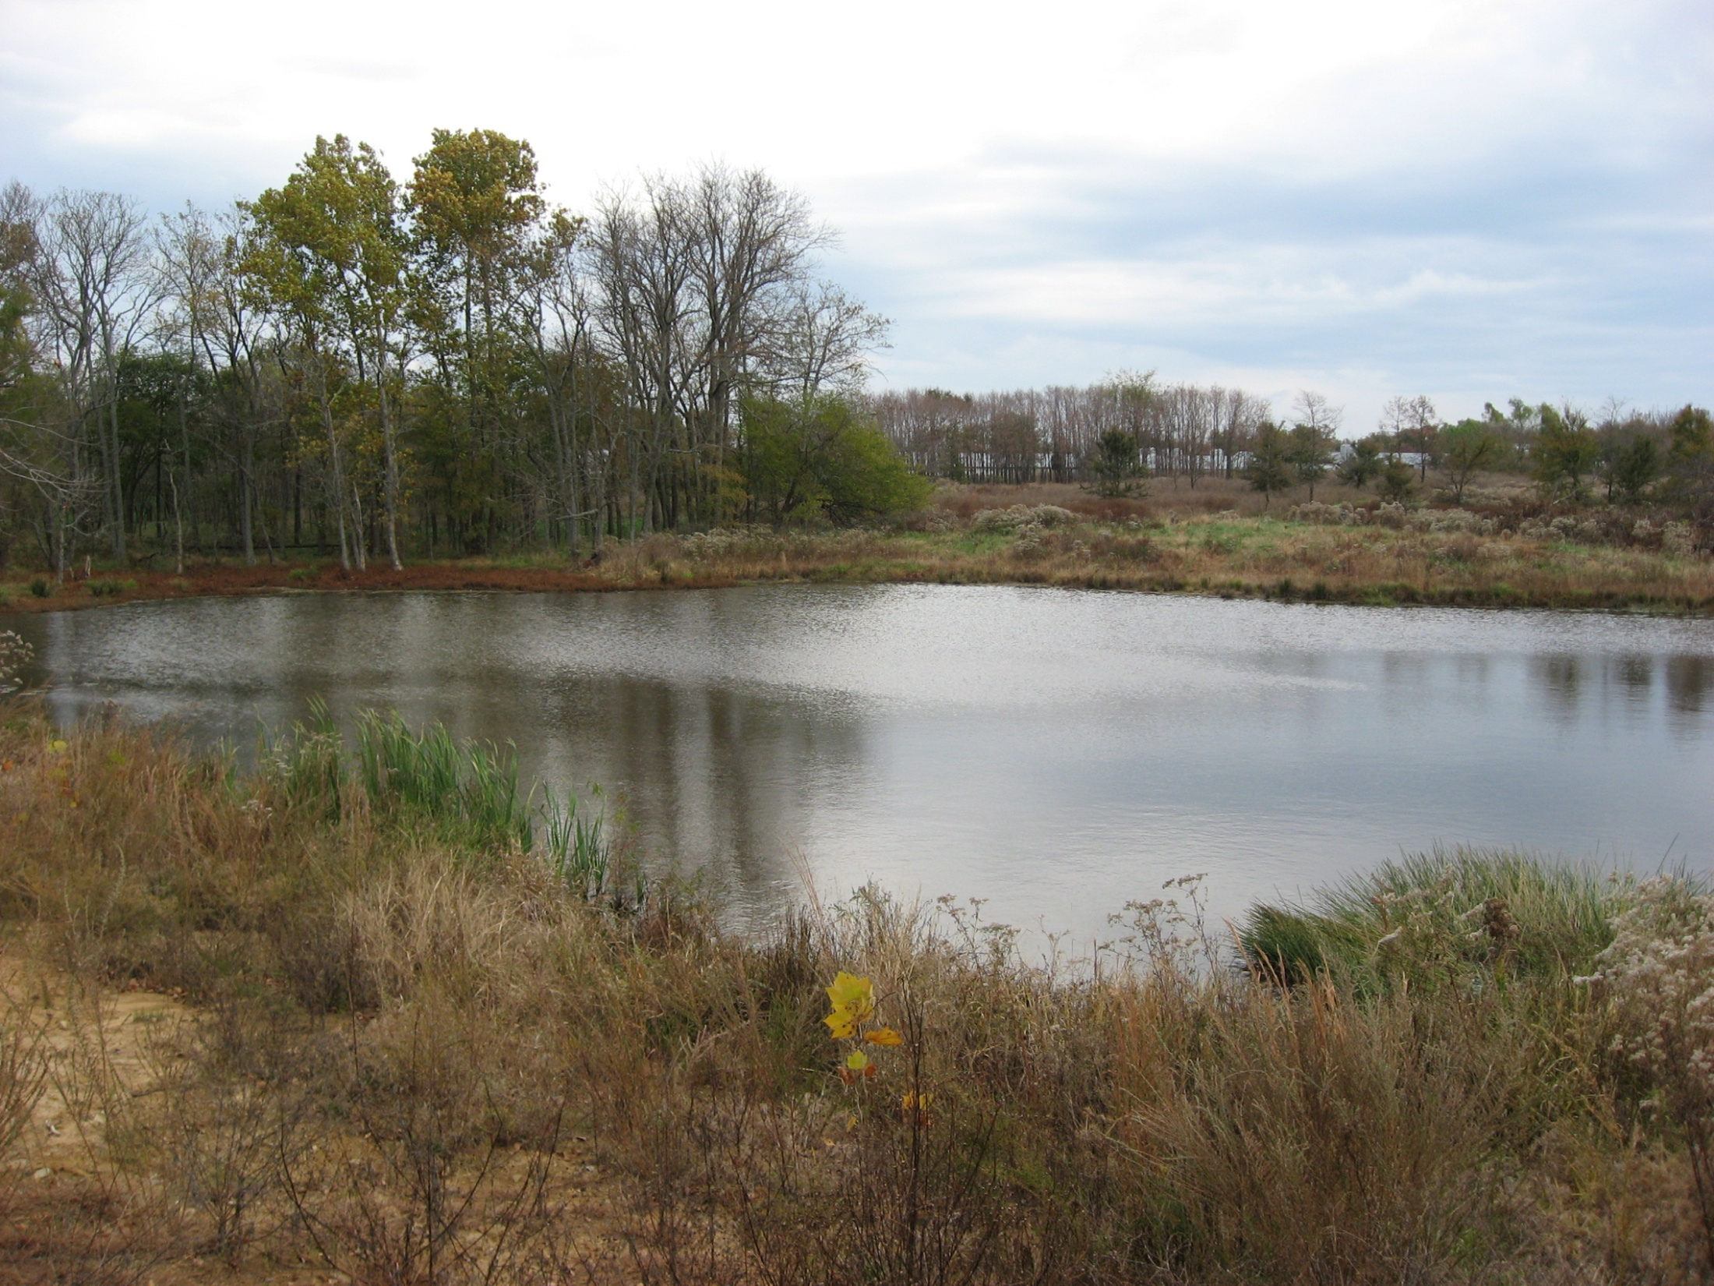
Ponds can be an alternative water source and trap nutrients and sediment
Notes:
4

Slide 5
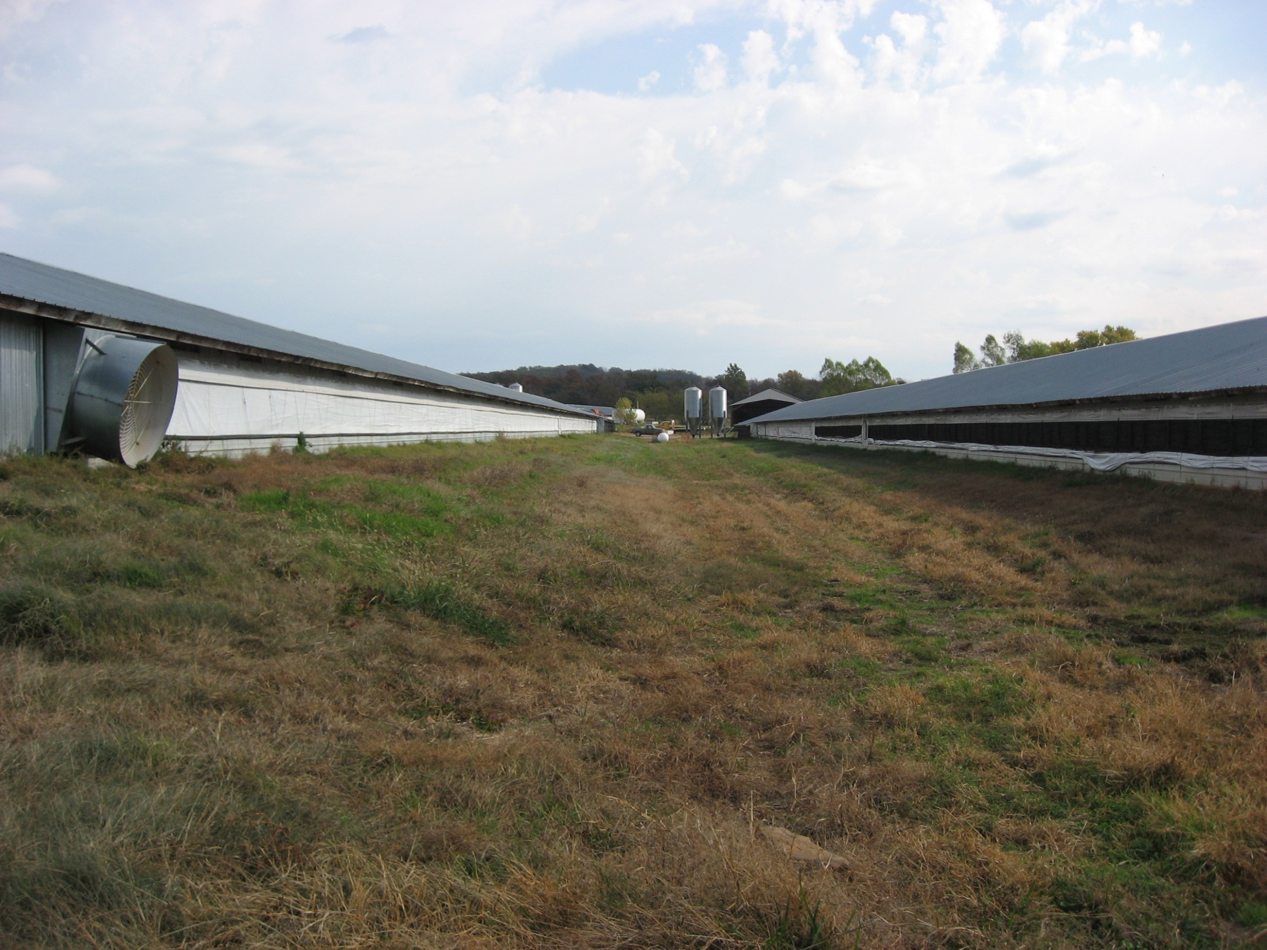
Notes:
5

Slide 6
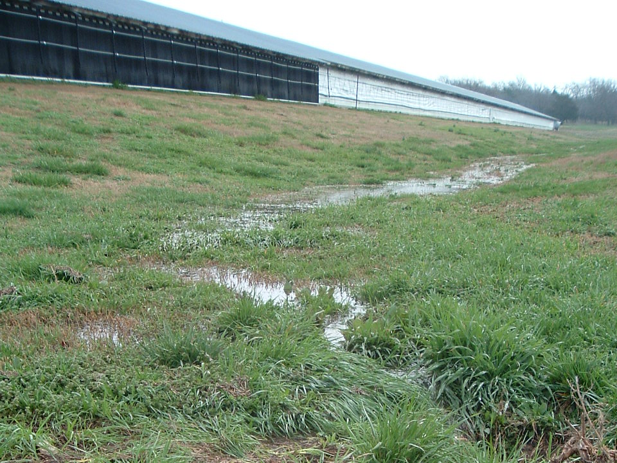

Slide 7
Rationale
Unmanaged runoff from and around poultry houses can be a source of nutrients and sediment to area waters
  On-farm reuse of captured runoff water
    House coolant, drinking water, pasture irrigation
A more closed, internal nutrient and water recycling system is developed, with less off-farm losses
Notes:
7

Slide 8
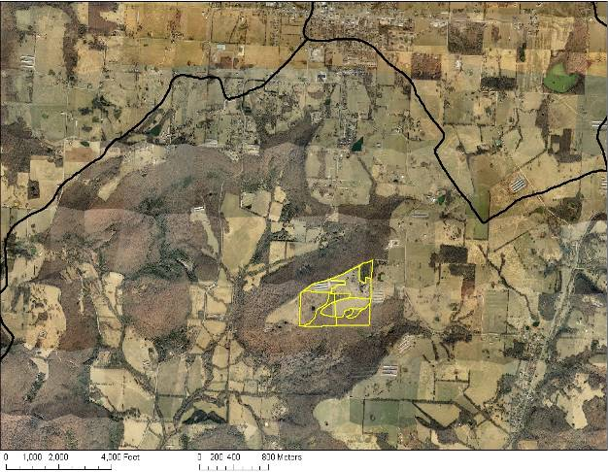
Lincoln
Upper Ballard Creek
111101030604
Moores Creek-Muddy Fork
111101030402
Headwaters Baron Fork
111101030402
Study farm
N
0
1,000
2,000
Feet

Slide 9
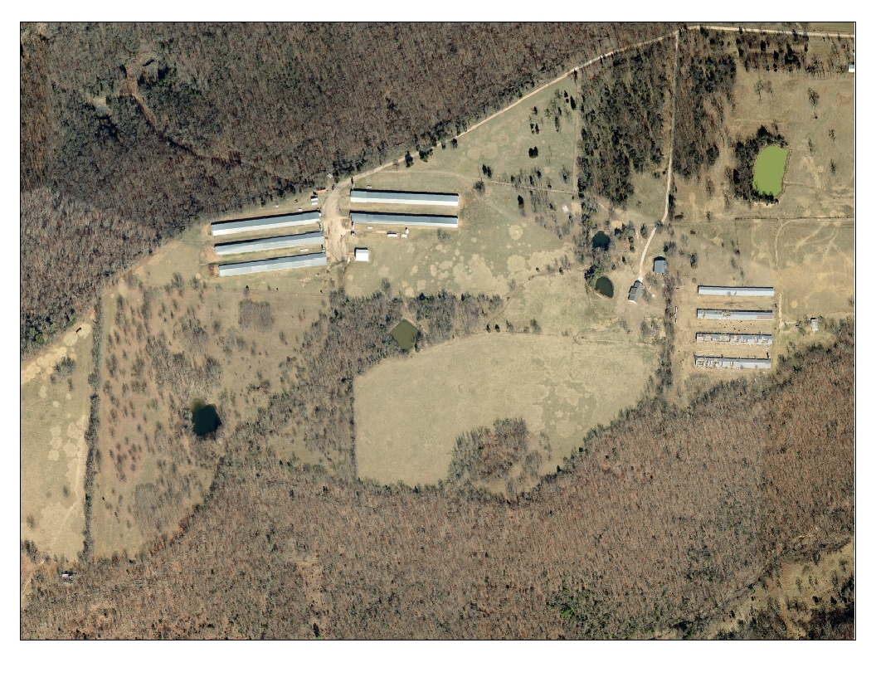
7.0 ac
10.8 ac
24.5 ac
21.9 ac
3.3 ac
13.6 ac
4.3 ac
11.6 ac
12.4 ac

Slide 10
Jo
ErF
HoF
LkC2
LnC2
ApB
Jo
LnC2
LkC2
Map unit Map unit name
ApB Apison loam, 1 to 3% slopes
ErF Enders – Allegheny complex, 20 to 40% slopes
HoF Hector-Mountainburg stony fine sandy loams, 3 to 40% slopes
Jo Johnsburg silt loam
LkC2 Linker loam, 3 to 8% slopes, eroded
LnC2 Linker gravelly loam, 3 to 8% slopes, eroded
ErF

Slide 11
Untreated ditch runoff
Grassed waterway
Collection pond

Slide 12
Plan of study
Monitor P, N and sediment in runoff
  Monitor flow, P, N and sediment at
    Untreated site
    Treated site – grassed waterway collection
    Pond volume and water quality
Notes:
12

Slide 13
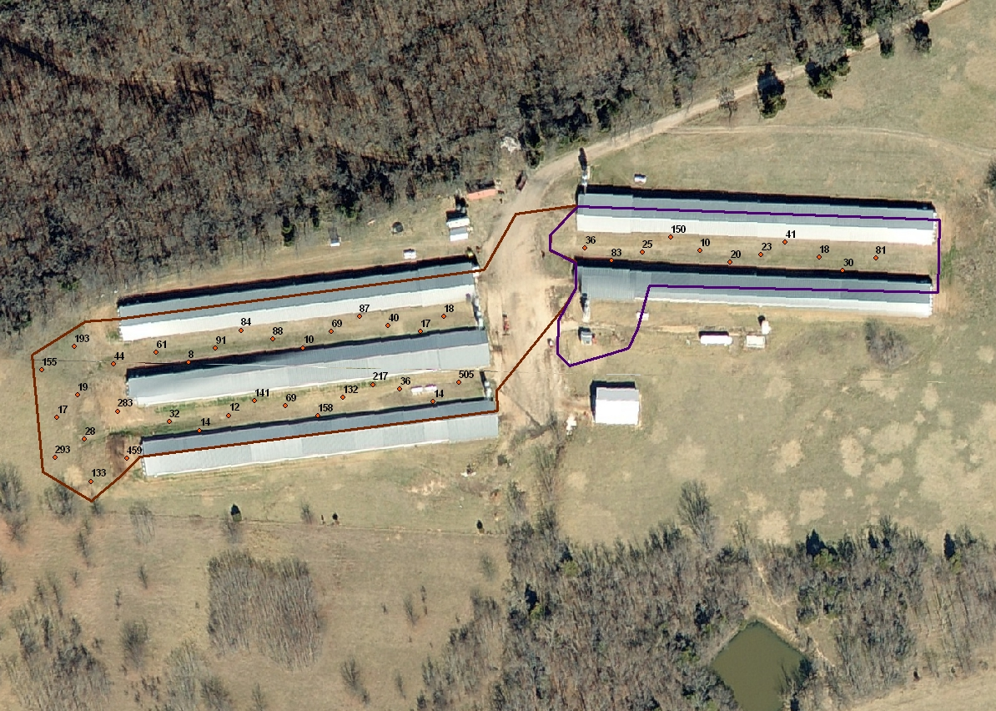
36
20
81
30
40
18
84
193
61
50
18
203
158
13
133

Slide 14

Sampling sites

Slide 15
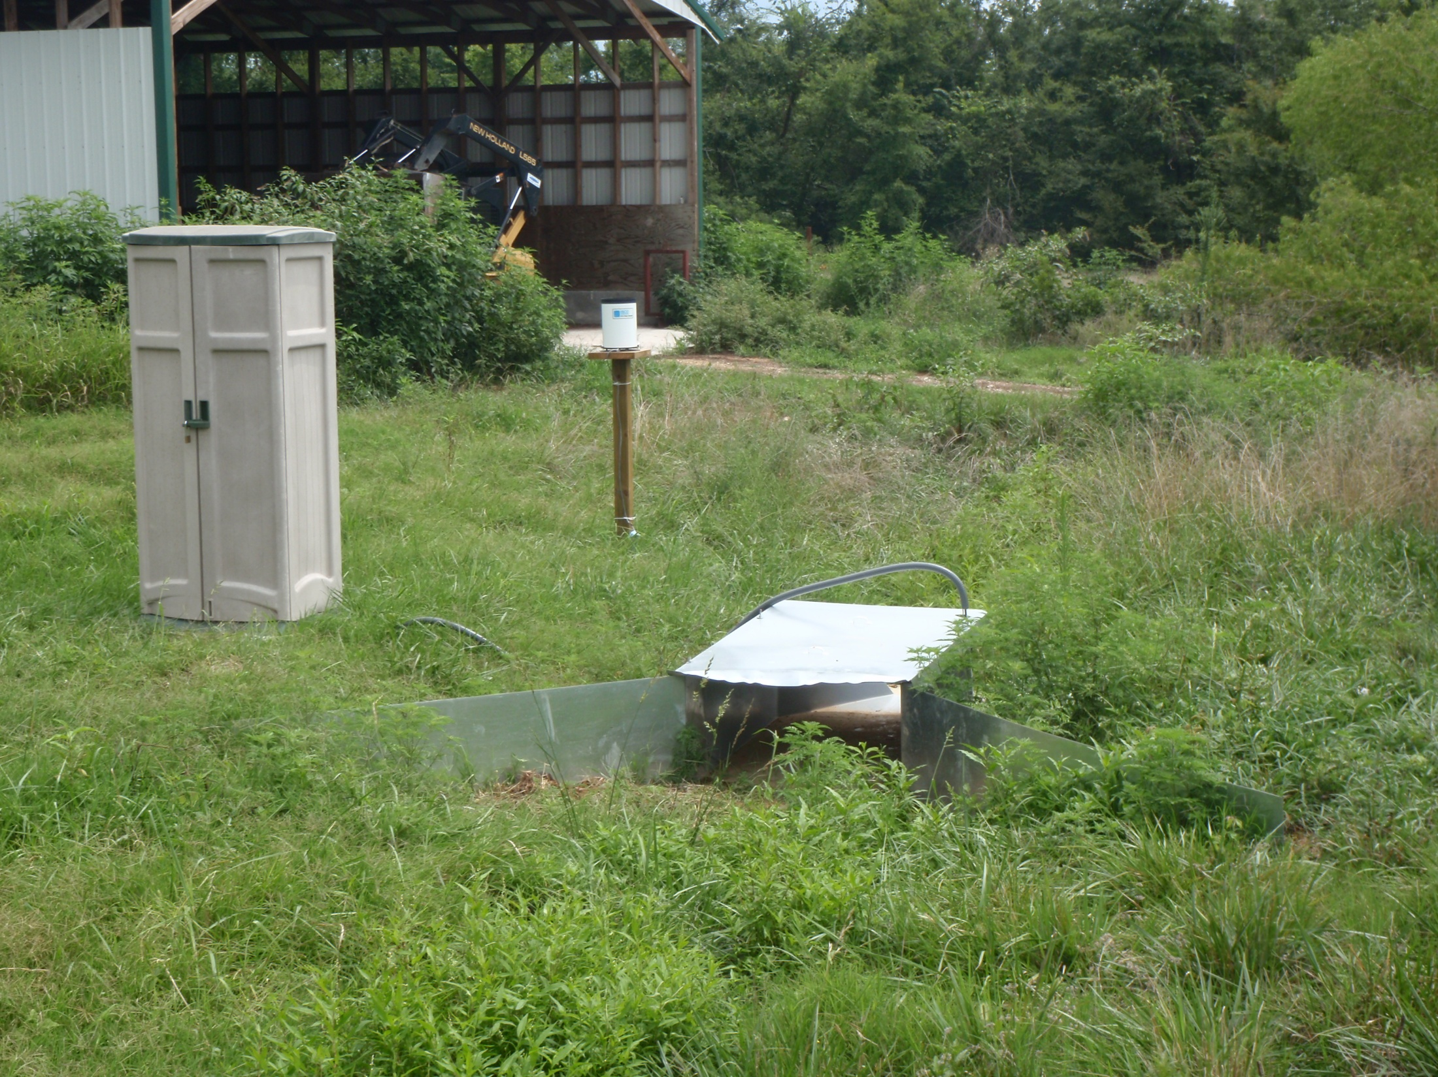

Slide 16
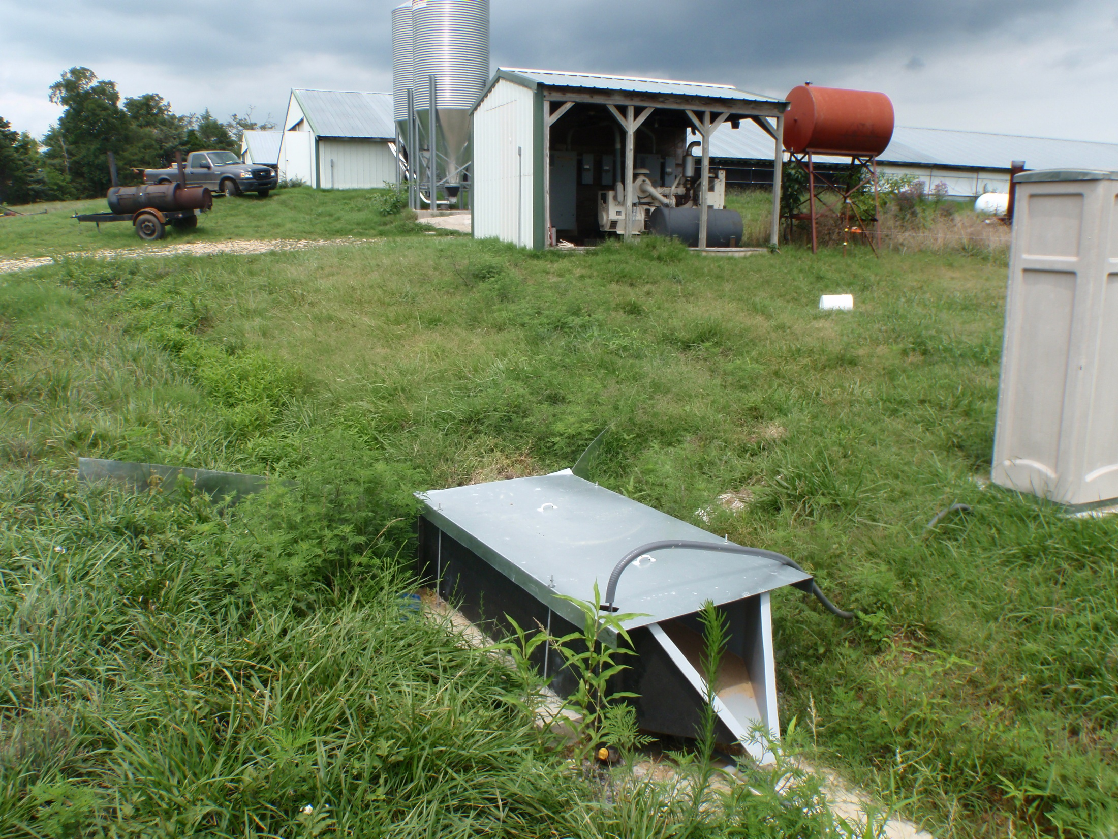

Slide 17

Sampling sites

Slide 18
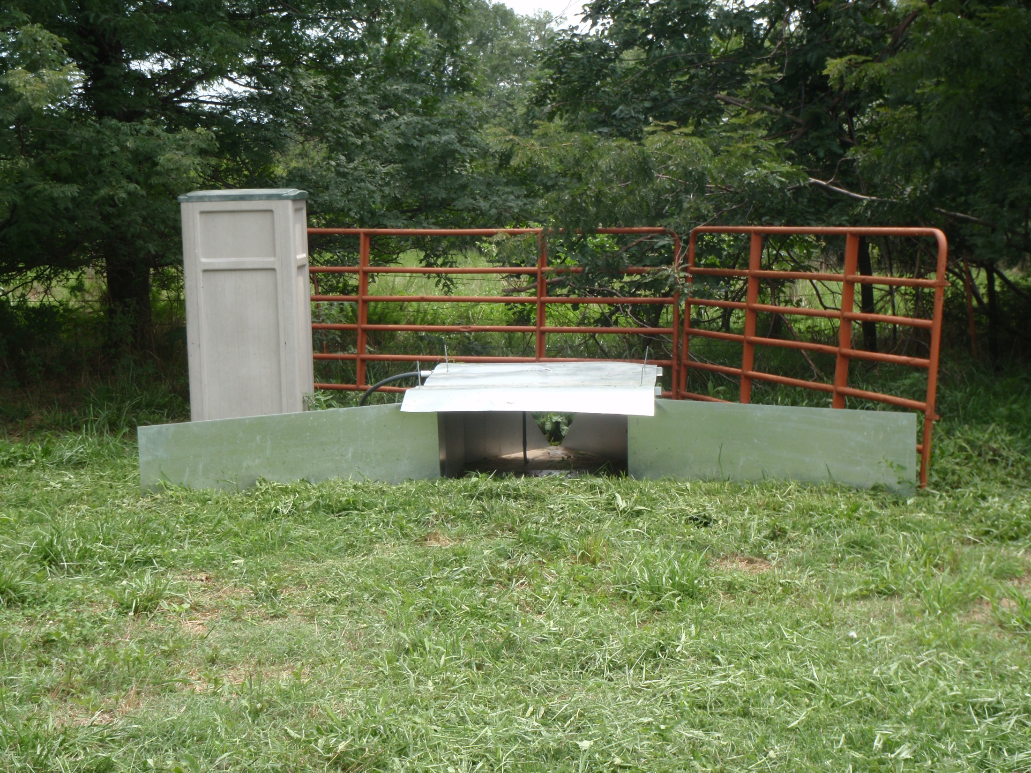

Slide 19
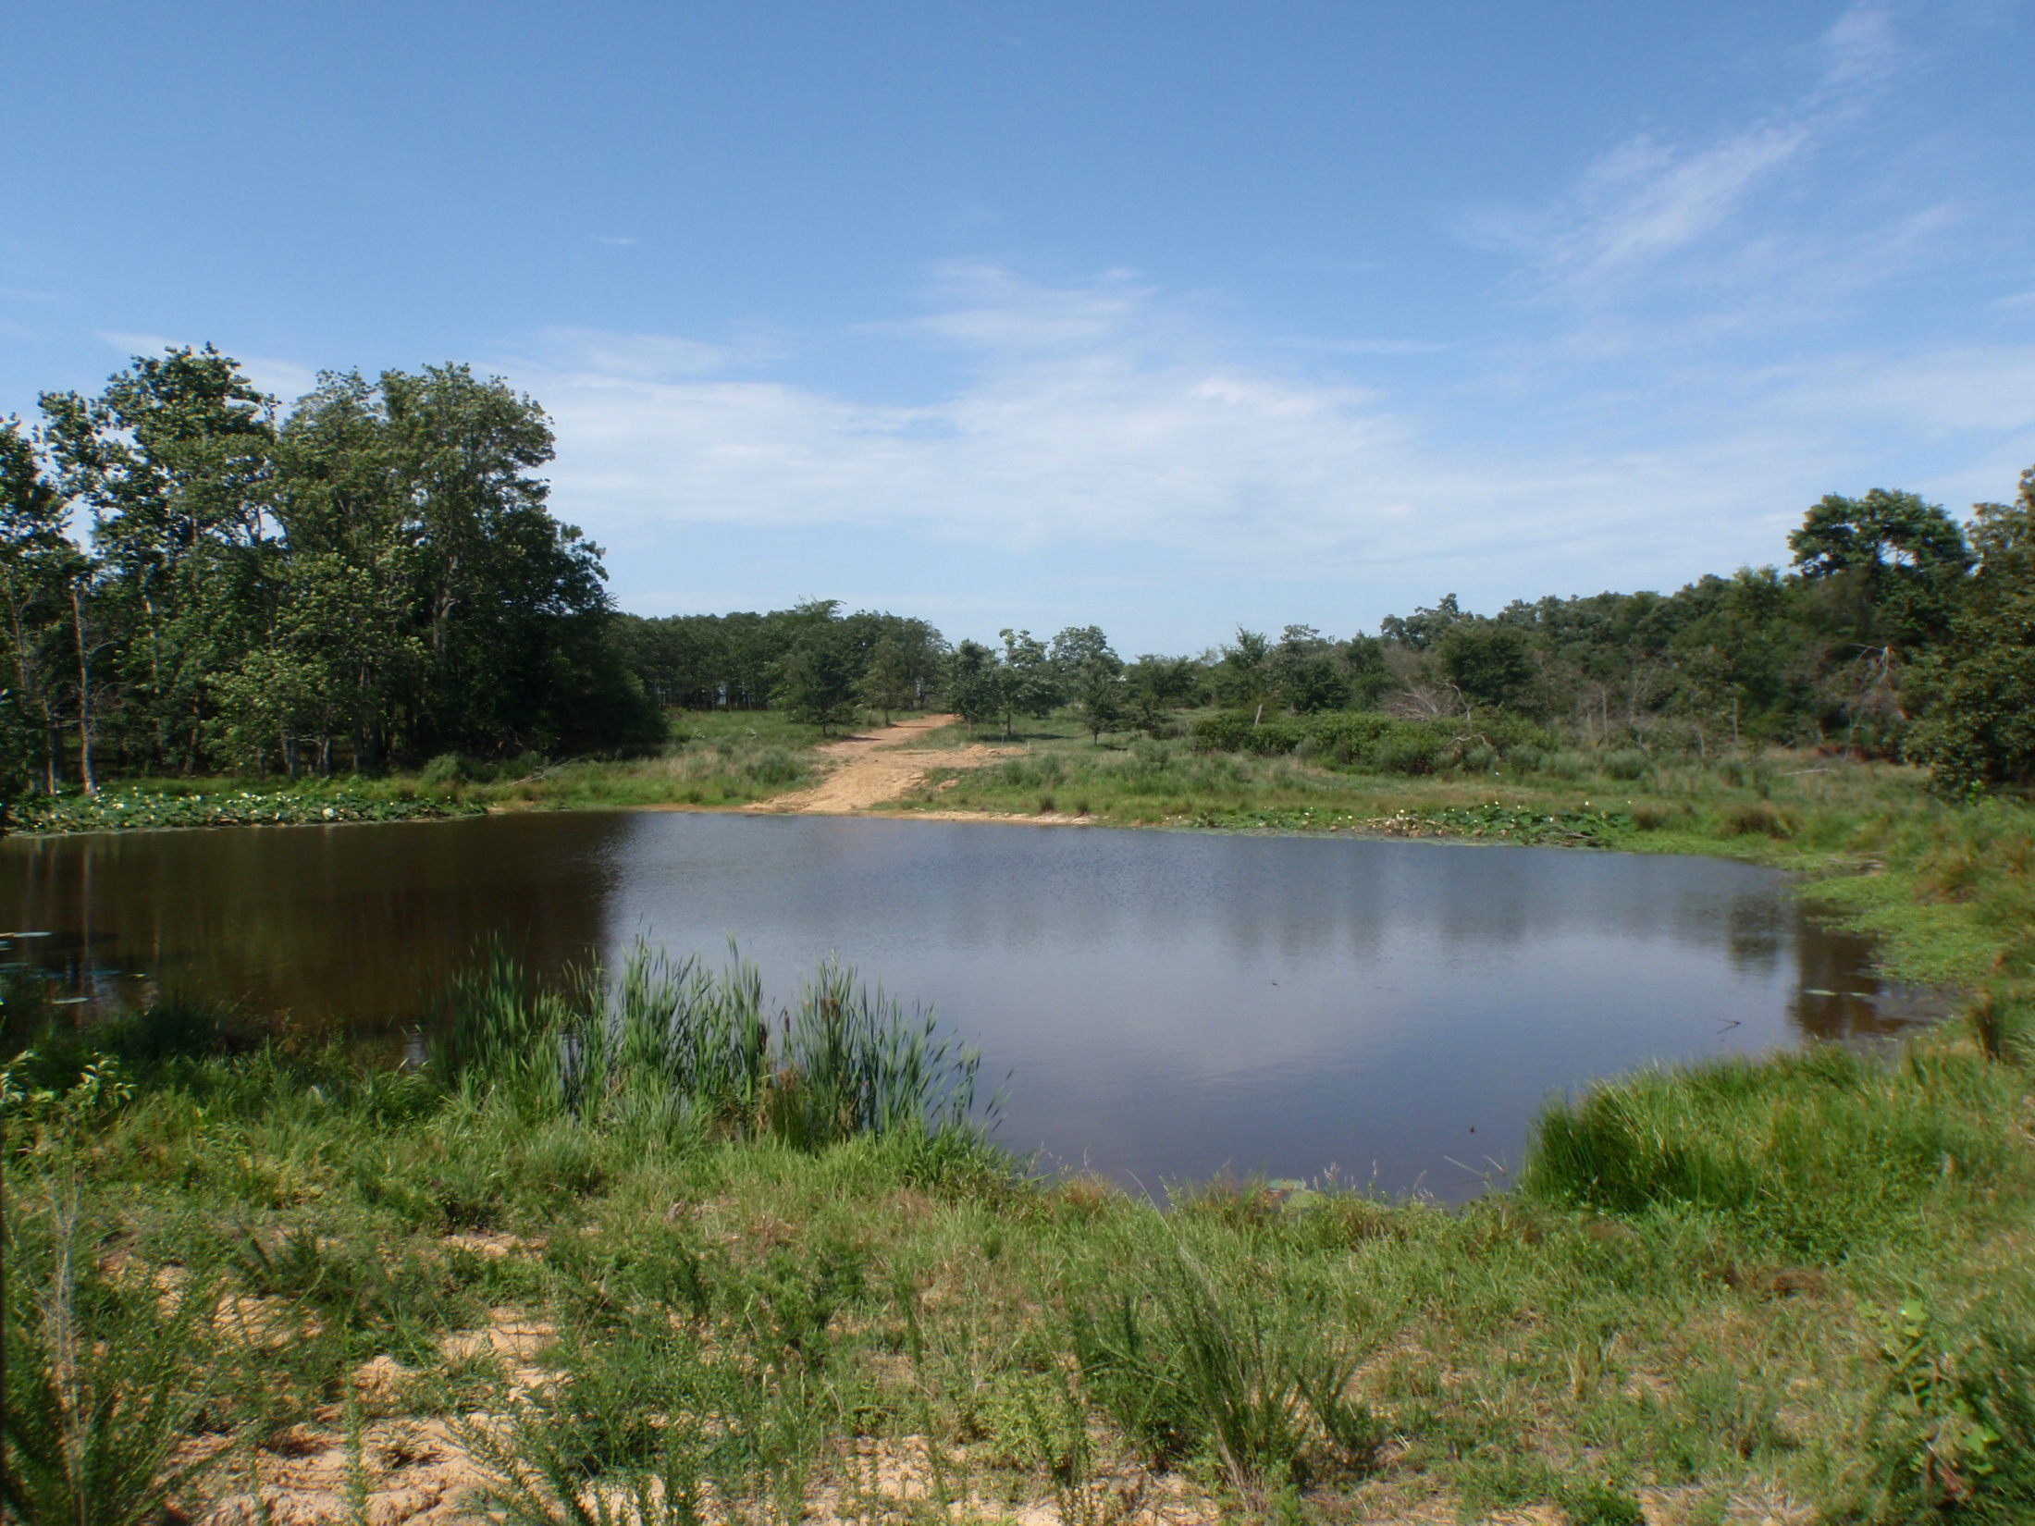

Slide 20
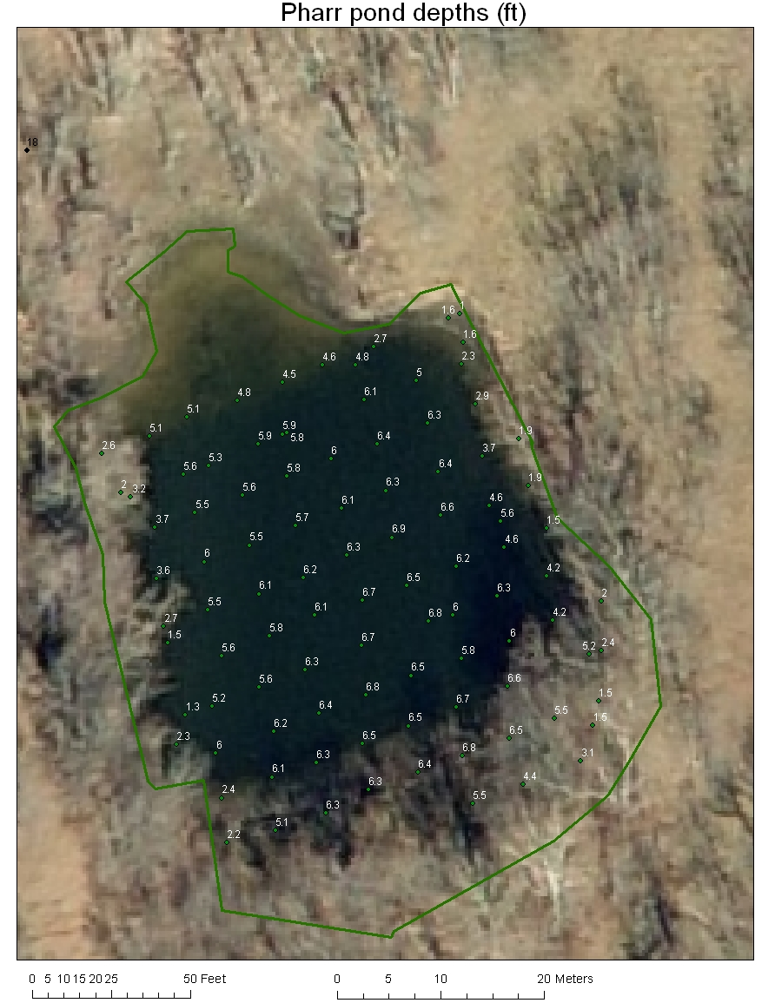
1.6
5.9
6.3
6.3
6.2
1.3
6.8
6.8

Slide 21
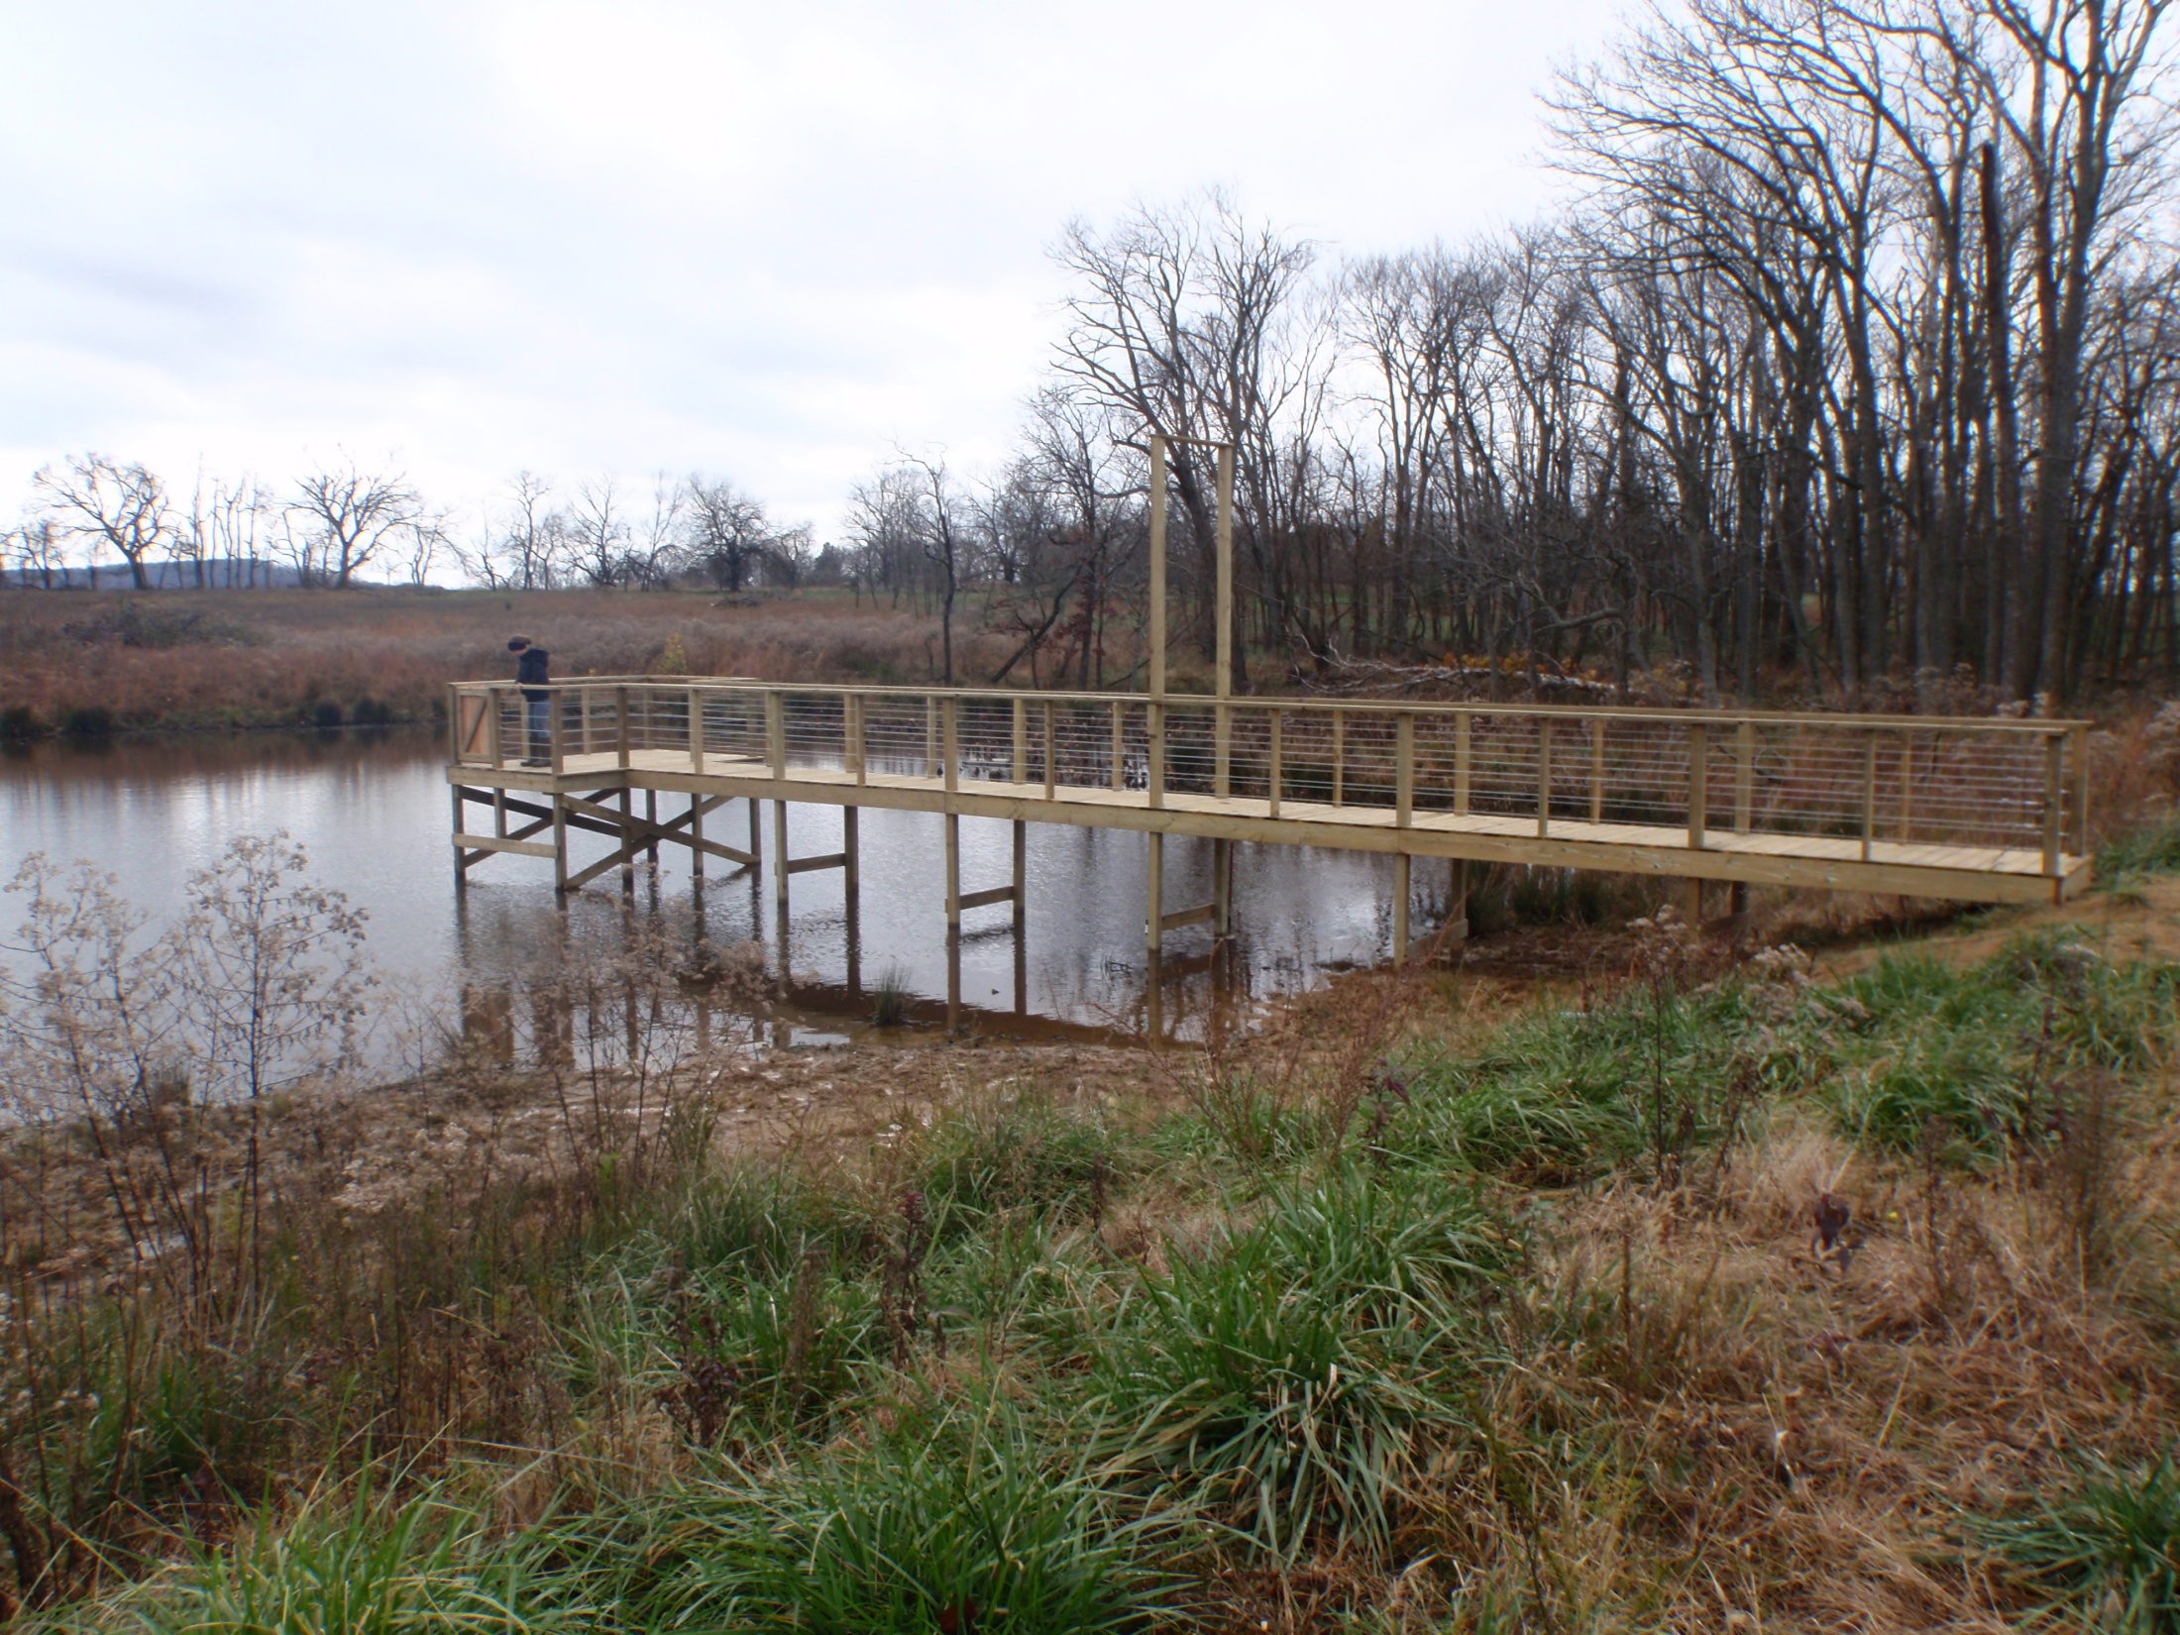

Slide 22
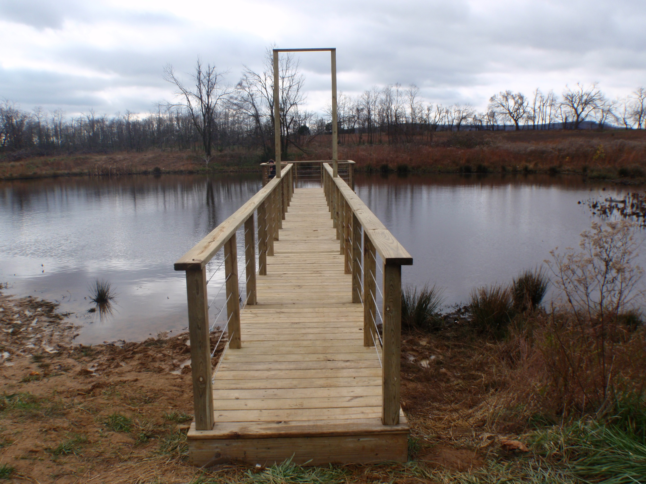

Slide 23
Pond depth, m
12:00
00:00
12:00
00:00
12:00
00:00
12:00
July 23
July 24
July 25

Slide 24
Pond temperature, ⁰C
12:00
00:00
12:00
00:00
12:00
00:00
12:00
July 23
July 24
July 25

Slide 25
Pond water pH
12:00
00:00
12:00
00:00
12:00
00:00
12:00
July 23
July 24
July 25

Slide 26
Dissolved Oxygen, mg/L
12:00
00:00
12:00
00:00
12:00
00:00
12:00
July 23
July 24
July 25

